Slide 1
Feature Matching: Using Deep-Learning Method SuperGlue https://arxiv.org/abs/1911.11763
Daniel Scott & Rencheng Wu

Slide 2
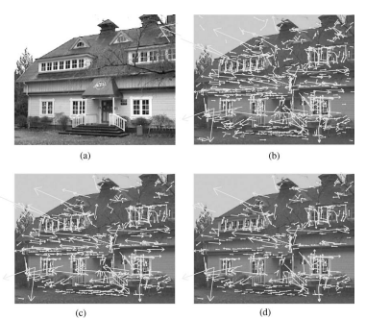
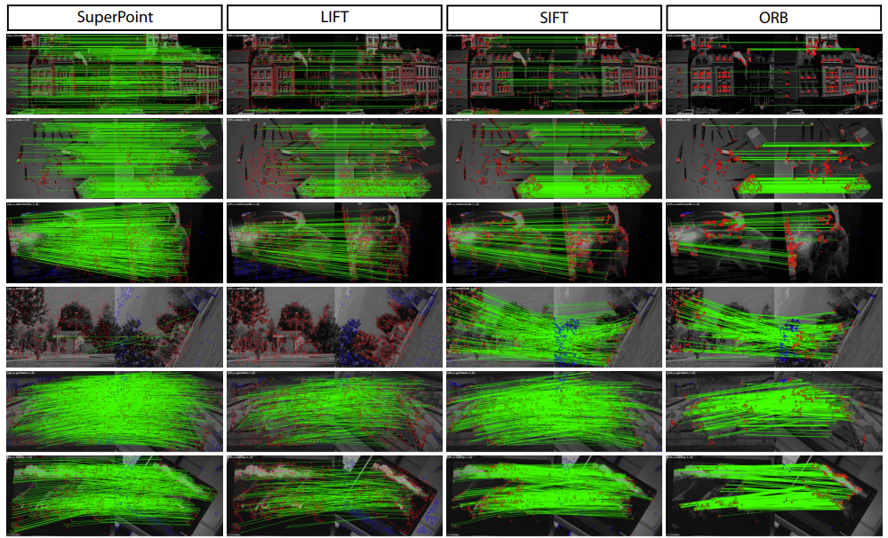
Feature Matching
Objective: Identify points or landmarks within images to establish links between differing views and frames.
Significance: Object Recognition, Image Stitching, Simultaneous Localization and Mapping (SLAM) ^{[1]}, etc.
Classification: Two overarching techniques
Traditional Feature Matching: Utilizes handcrafted algorithms to develop interest Point (keypoints) and descriptors
SIFT (Scale-Invariant Feature Transform), SURF (Speeded-Up Robust Features), ORB (Oriented FAST and Rotated BRIEF)
Deep-Learning Based Feature Matching: Utilizes neural networks to learn and develop feature representations
DeepDesc, LIFT (Local Invariant Feature Transform), SuperPoint
Figure 1: Example of keypoints and descriptor using SIFT ^{[2]}
Figure 2: Comparison of Feature Matching Techniques both Traditional and Deep-Learning Based ^{[3]}
Notes:
SLAM: Process of building a map of an environment and locating the position currently in the map

Slide 3
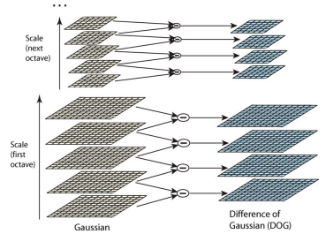
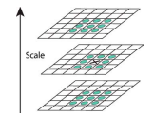
SIFT (Scale-Invariant Feature Transform)
Purpose: Develop a method that is invariant to scale, rotation, and illumination
Detection: Locates keypoints using scale-space extrema from the Difference of Gaussians.
Description: Creates descriptors using gradient orientation histograms around keypoints.
Disadvantages:
Computational Load: More computationally intensive, potentially slower on large datasets.
Application Requirements:
For real-time applications, SuperPoint's speed might be advantageous (e.g., augmented reality, robotics).
For applications where the highest possible matching accuracy is required and computational time is less of a concern, SIFT might be preferred (e.g., offline 3D reconstruction).
Environmental Conditions: In highly variable environments, the learned robustness of SuperPoint might outperform SIFT.
Figure 3: SIFT keypoint detection ^{[2]}
Figure 4: SIFT local extrema keypoint detection ^{[2]}

Slide 4
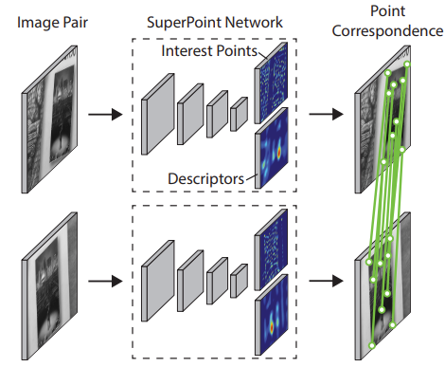
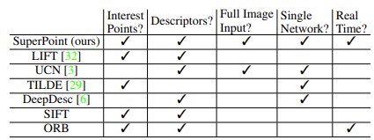
SuperPoint
Purpose: To autonomously and reliably detect and describe detailed keypoints and descriptors for robust and repeatable results
Significance: Developed method produces robust feature matching across scales, rotations, and illuminations, also improves computational time
Technique:
Keypoint Detection:
Processes images through convolutional layers to create feature maps at different scales.
Identifies keypoints by locating peaks in a heatmap, which signifies areas with high probability of being distinctive.
Descriptor Generation:
Associates each keypoint with a unique descriptor by examining the surrounding pixels and capturing the pattern.
This description remains consistent even when the image is transformed, allowing for reliable matching.
Implementation:
Involves non-maximum suppression to filter out less prominent keypoints and normalization to maintain descriptor reliability.
Figure 5: SuperPoint Feature Matching Process ^{[3]}
Figure 6: Comparison of Feature
Matching Properties ^{[3]}

Slide 5
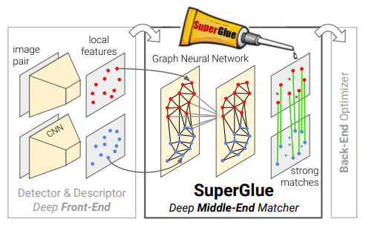
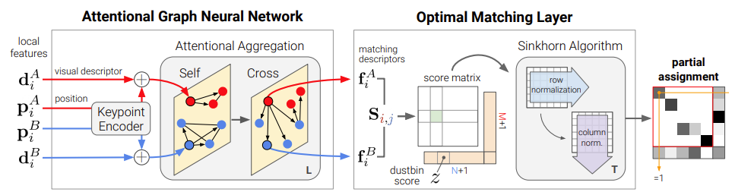
Methodology: SuperGlue
Purpose: Used as a middle-end process with other feature matching methods
Significance: Improve the keypoints and descriptors through further neural network process
Technique:
Encode keypoints: Normalize and fuse visual feature with location information.
Graph Neural Network: Incorporate self and cross-attention layers to improve keypoints and descriptors.
Final Projection Layer: Refine feature representations.
Optimal Transport Layer: Apply optimization algorithm for matching features between images.
Figure 8: SuperGlue keypoint and descriptor optimization process [4]
Figure 7: Implementation of SuperGlue within Feature Matching Process ^{[4]}
Notes:
The Sinkhorn algorithm is then used to process the augmented score matrix. This algorithm iteratively normalizes the rows and columns of the matrix to make it doubly stochastic. In other words, the row sums and column sums are made equal to one, under certain conditions. This normalization process essentially balances the matrix in a way that the scores can be interpreted as probabilities of matches between keypoints.

Slide 6
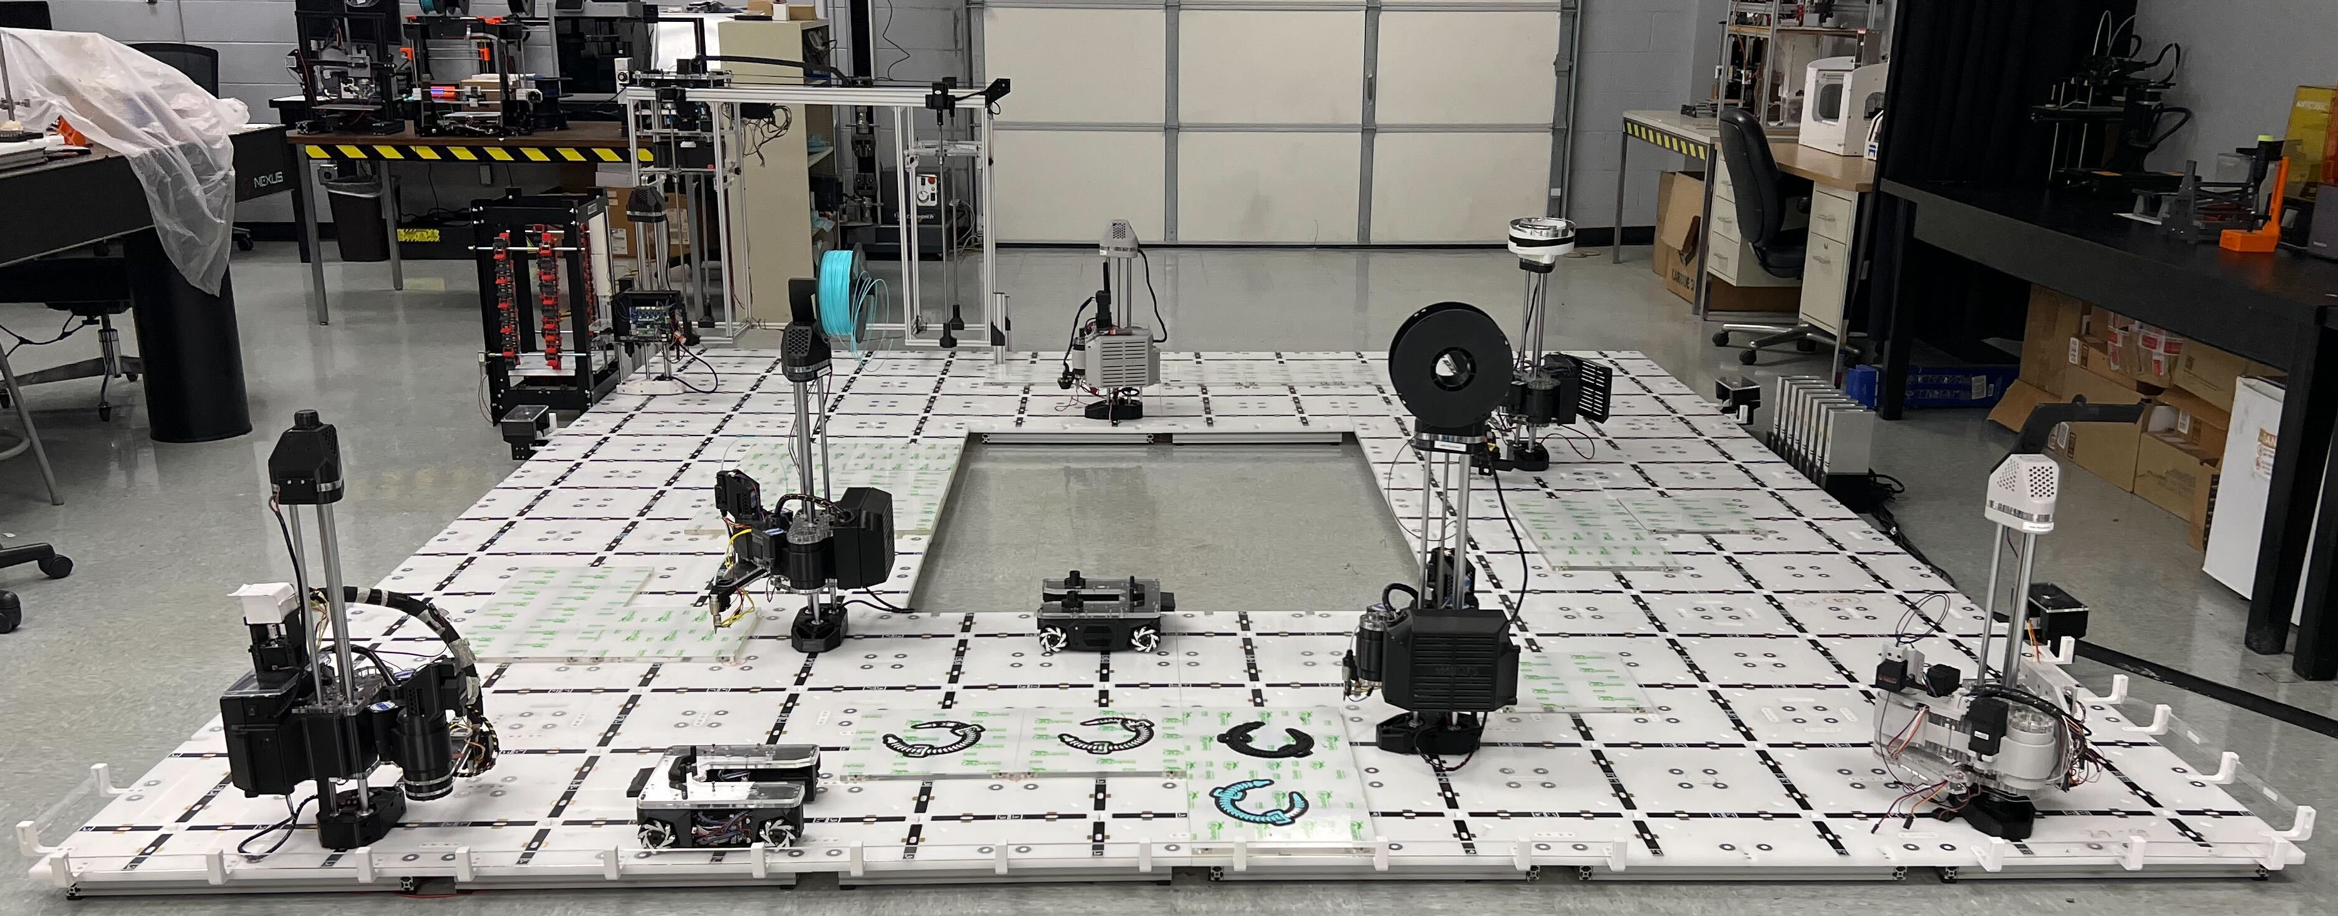
Implementation
Real time demonstration of a platform that has 7 robotic arms and 2 mobile robots
Testing:
Features were pulled and matched according to orientation image taken.
Results are shown in the following figures.
Compare with photos matching.
Figure 9: SCARA Robotic Arms Platform

Slide 7
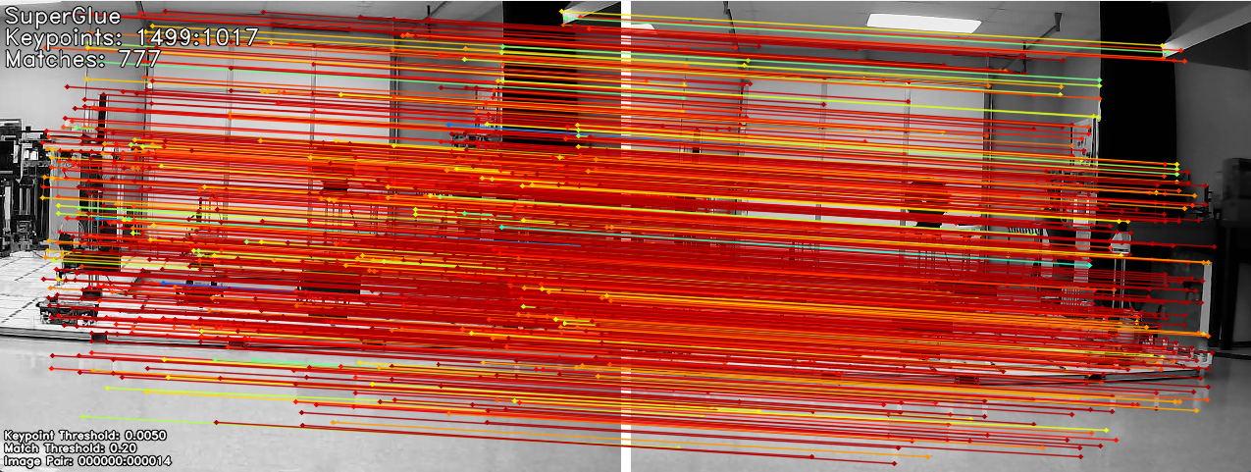
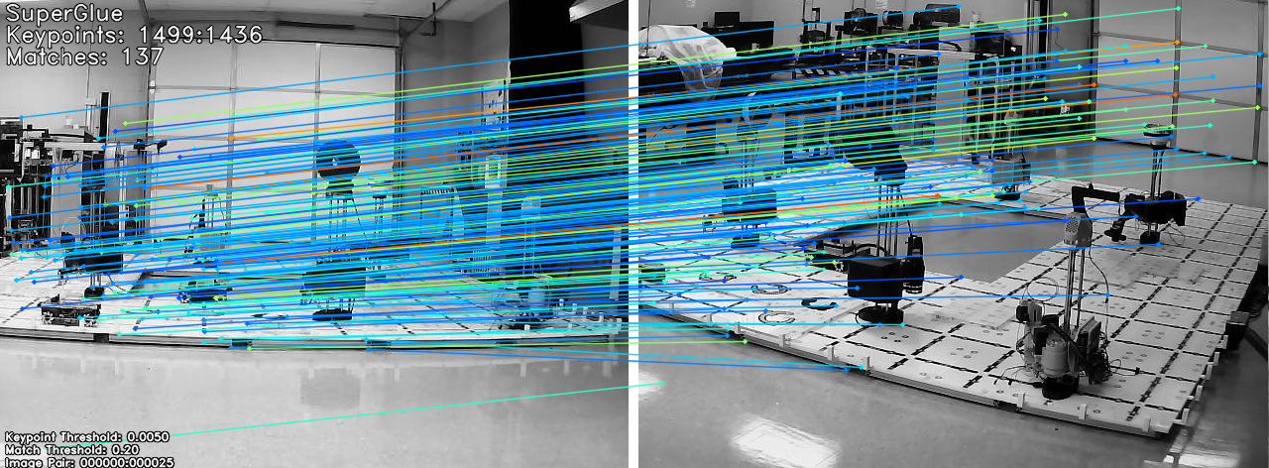
Real-time matching
Front View:
Keypoints are 1499 vs 1017
SuperGlue produced 777 matching features
Matches were given a high error, signifying the low confidence of match
Right Corner:
Keypoints are 1499 vs 1436
Image matches was greatly reduced to 137 total matches
These matches showed lower error producing a higher confidence per match
Figure 10: Implementation of SuperGlue, (a) Original image,
(b) Frontal view of image
Figure 11: Implementation of SuperGlue, (a) Original image,
(b) Right corner view of image

Slide 8
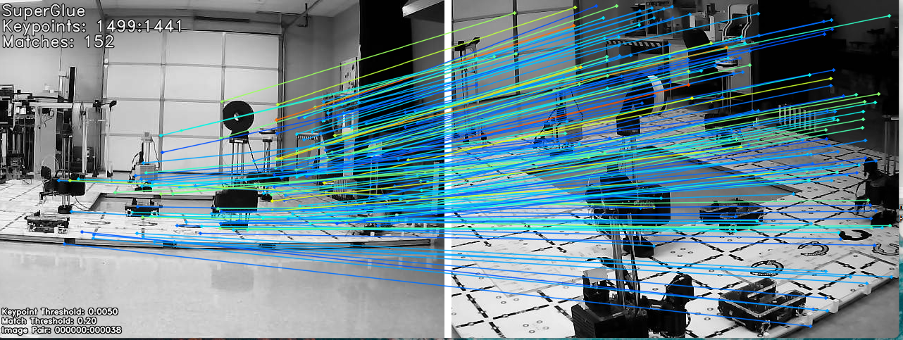
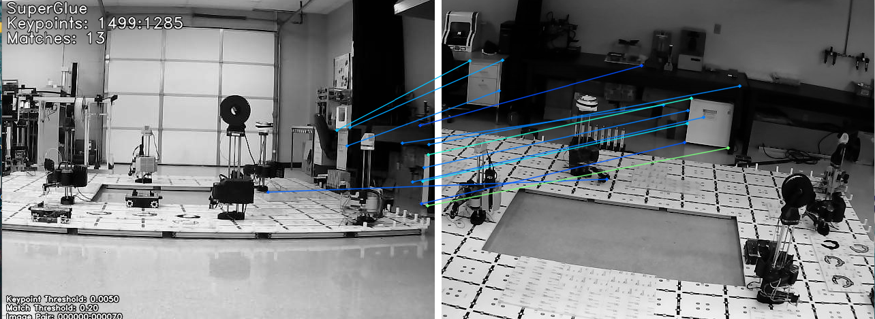
Real-time matching
Left Corner:
Keypoints are 1499 vs 1441
SuperGlue produced 152 matches
The error given was low, so matches have high confidence
Left View:
Keypoints are 1499 vs 1285
SuperGlue gave 13 matches
The low matches can be the cause of the viewpoint being so far off
Figure 12: Implementation of SuperGlue, (a) Original image,
(b) Left corner view of image
Figure 13: Implementation of SuperGlue, (a) Original image,
(b) Left side view of image

Slide 9
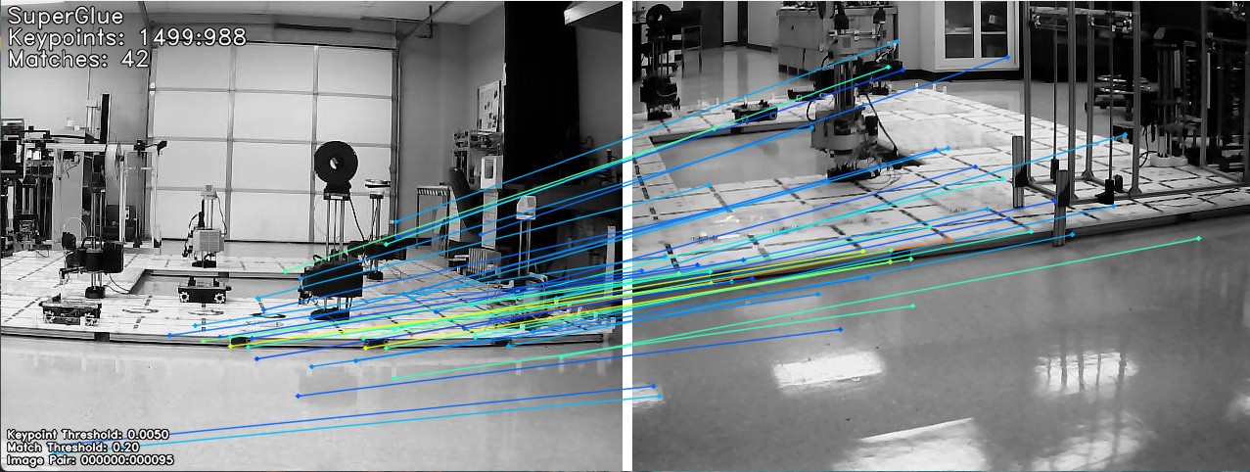
Real-time matching
Back View:
The matches are incorrect.
This shows limitations of SuperGlue, meaning the model will determine matches even when there are none.
Figure 14: Implementation of SuperGlue, (a) Original image, (b) Back view of image

Slide 10
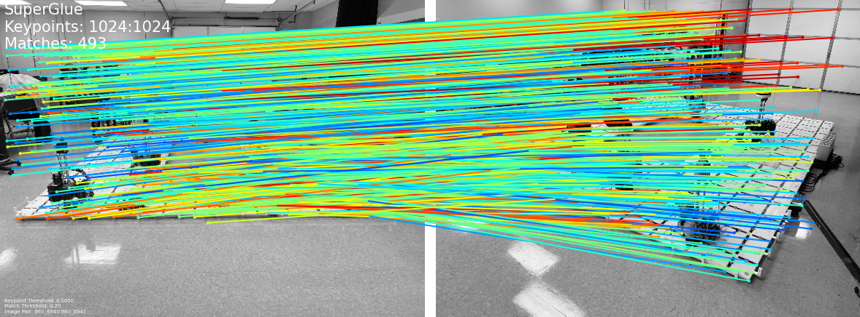
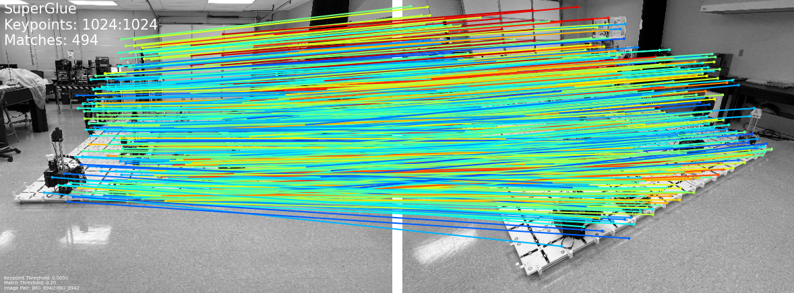
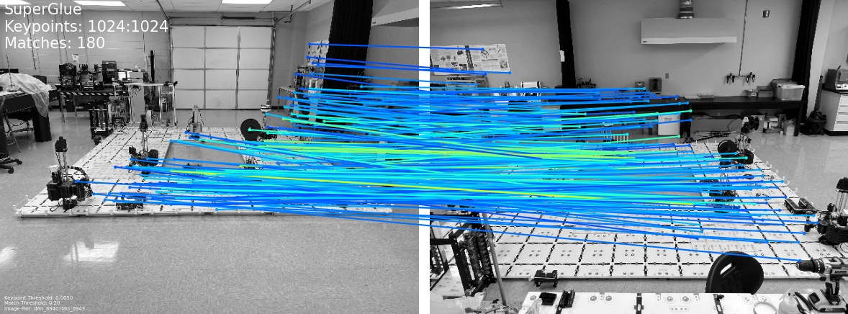
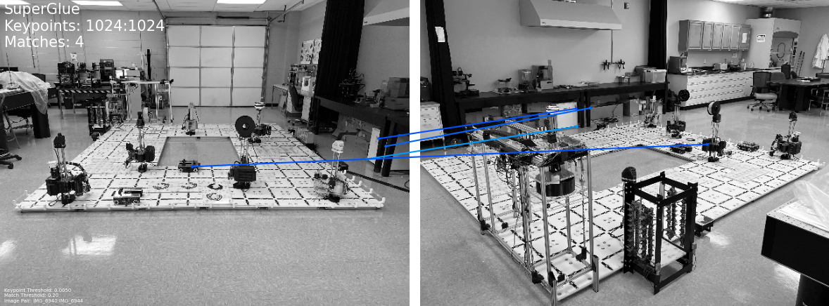
Photos matching
Figure 15: Photos Pairs

Slide 11
Conclusion
SuperGlue is a powerful middle-end keypoint and descriptor optimization process
Advantages:
Produced improved accuracy when compared with other feature matching methods
Improved computational time allowing for real-time application
Limitations:
Requires keypoint and descriptor generation method
Current model has issues with overfitting causing problems with generalization
Optimization for local and global matches

Slide 12
References
[1] H. Durrant-Whyte and T. Bailey, "Simultaneous localization and mapping: part I," in IEEE Robotics & Automation Magazine, vol. 13, no. 2, pp. 99-110, June 2006, doi: 10.1109/MRA.2006.1638022.
[2] David G Lowe. Distinctive image features from scaleinvariant keypoints. International Journal of Computer Vision, 60(2):91–110, 2004.
[3] Daniel DeTone, Tomasz Malisiewicz, and Andrew Rabinovich. SuperPoint: Self-supervised interest point detection and description. In CVPR Workshop on Deep Learning for Visual SLAM, 2018.
[4] P.-E. Sarlin, D. DeTone, T. Malisiewicz, and A. Rabinovich, “Superglue: Learning feature matching with Graph Neural Networks,” arXiv.org, https://arxiv.org/abs/1911.11763, 2020

Slide 13
Thank You, Questions?

Slide 14

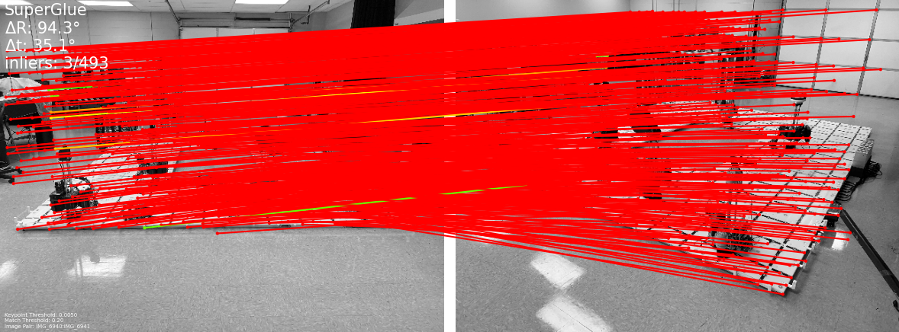
Extra data needed
The script needs each line in the pairs file to have 38 entries for evaluation:
Additional Parameters: The remaining 36 entries might include camera intrinsics, extrinsics, and possibly other information necessary to perform a detailed evaluation. This could involve rotation matrices, translation vectors, and other camera parameters.

Slide 15
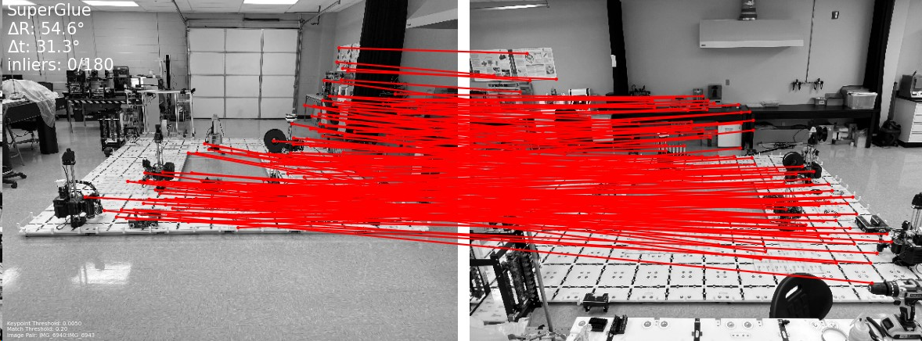
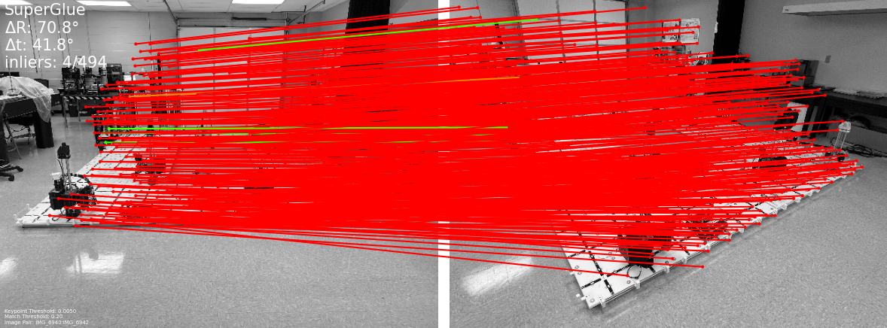
Evaluation failed

